Slide 1
- U.S. Department of Commerce - Mapping Software for Trade Enforcement and Compliance Information
Project Team: Chenghao He
Salman Jamil
Sheng-Lun Chen
Sonal Malavia
Vandana Haradikar(Project Manager)
Project Advisor: Sakir Yucel
Project Sponsor: Steve Williams Deputy Director, Program Operations, TANC
4/29/2014
Notes:
Deputy Director, Program Operations – Office of Trade Agreements and Negotiations Compliance

Slide 2
Agenda
Client Background, Problem and Requirements
Project Benefits
Project Scope, Analysis and Design
Project Development and Demo
Practices and Challenges
Future Work

Slide 3
Client Background
U.S. Department of Commerce
International Trade Administration (ITA)
Global Markets
Industry and Analysis
Enforcement and Compliance (E&C)

Slide 4
E&C Background
Functions:
Strengthen the competitiveness of US Industry
Promote Trade and Investment
Ensures Fair Trade through rigorous enforcements of US trade laws and agreements

Slide 5
E&C Services
AD/CVD
Enforcement of U.S. antidumping duty (AD) and countervailing duty (CVD)
Foreign Trade Zones
Improve U.S. Industry competitiveness by reducing the costs of U.S. operations
Policy and Negotiations Office of Trade Agreements Negotiation and Compliance(TANC)
Improve market access for U.S. exporters and investors.
Ensures compliance by foreign governments with U.S. trade agreements.

Slide 6
TANC Cases
Nearly 950 individual trade barriers successfully reduced/removed since August 2013
Technical Barriers to Trade
Unfair testing or labeling
Unfair certification requirements
Government Procurement problems
Border Barriers such as
Burdensome customs procedures
Import licensing requirements
Incorrect valuation or classification of exports
Discriminatory Investment requirements.

Slide 7
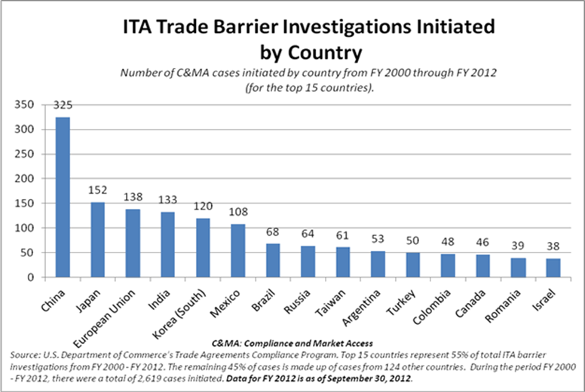
Program Results – by Country

Slide 8
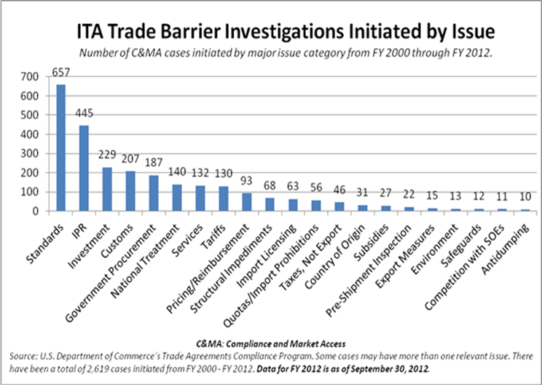
Program Results – by Issue

Slide 9
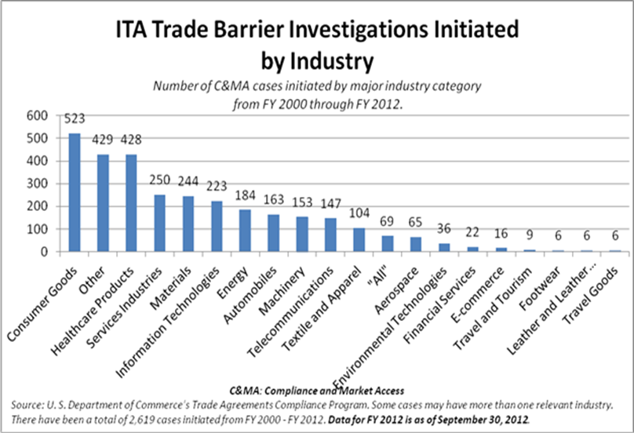
Program Results – by Industry

Slide 10
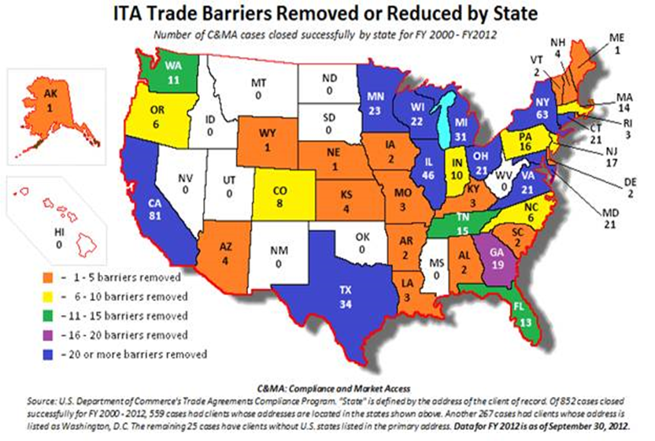
Program Results - Maps

Slide 11
Problem Statement
Problem Statement:
Result analysis through use of maps
Current caseload investigations and successes
Geographic coverage by Congressional district or region
Current process is manual
Manual Editing of the image file
Prevents easy pulling out of information
e.g. State-wise or City-wise

Slide 12
Project Benefit
Automation of current manual process
More flexible
Less time consumption
Save map images

Slide 13
Project Scope: Our Solution
Standalone, client rich mapping software – simple, intuitive UI
UI to select:
5 categories of data and file upload
Filters based on the case category selected
Save map images generated and displayed
Options for map display:
Shaded State – USA map (case count)
Shaded Country – Worldwide map (case count)
Shaded State – USA map (employees affected count)

Slide 14
Design – Application Flow
Upload Data File
Apply Filter(s)
Select Display Option
Generate & View Map
Select Case Category

Slide 15
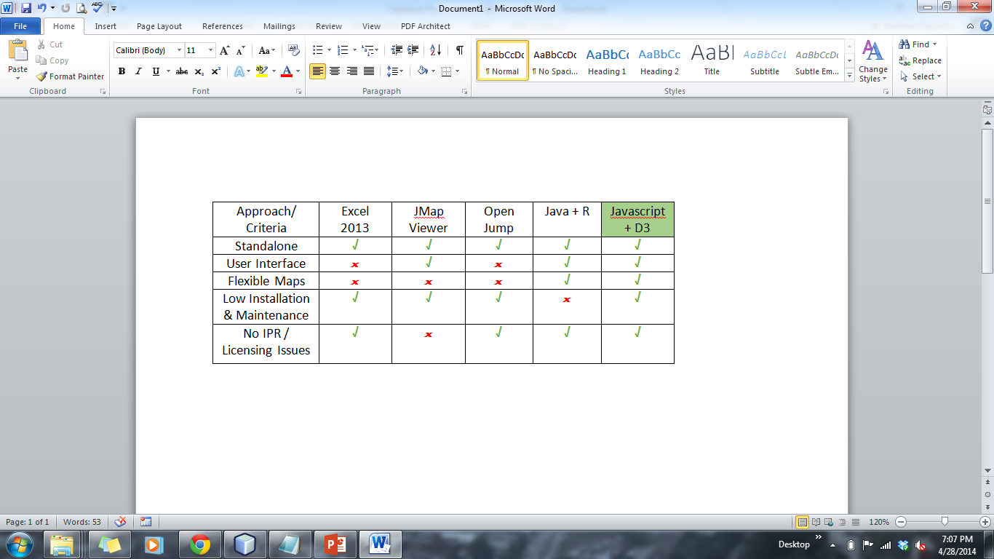
Design – Evaluation of Approaches

Slide 16
Development – Technical Details
Javascript
Stand-alone application with UI rendered in a browser
Multiple HTML forms to accept user input for data type, upload/read data from excel sheets, filters to be applied and map display type.
Javascript processing logic to generate Data Maps
JSON, D3
Static HTML Pages
GUI

Slide 17
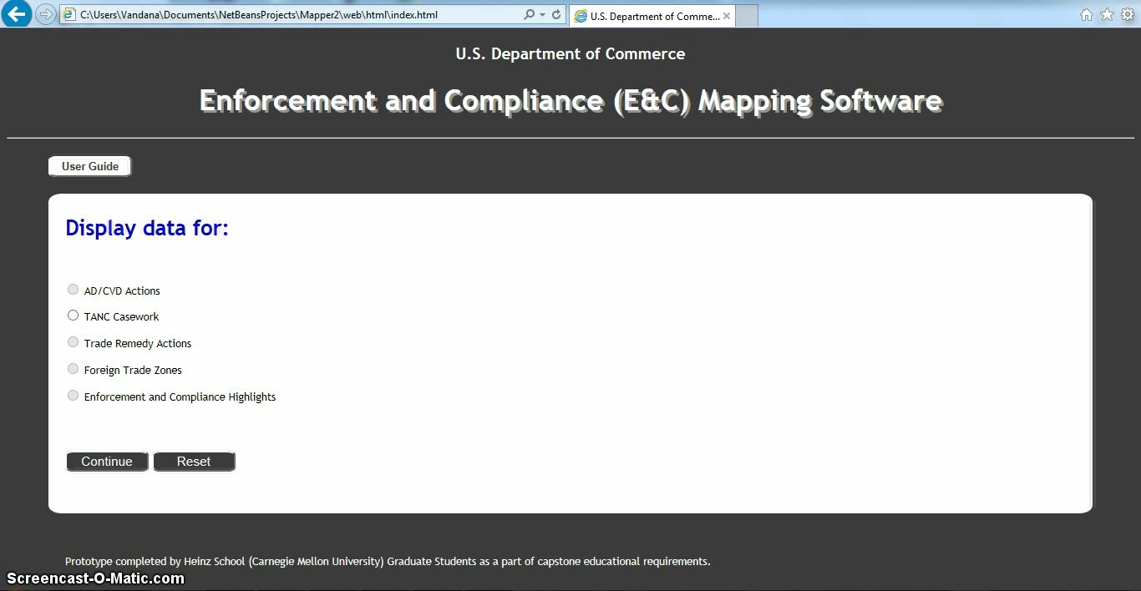
Product Demo

Slide 18
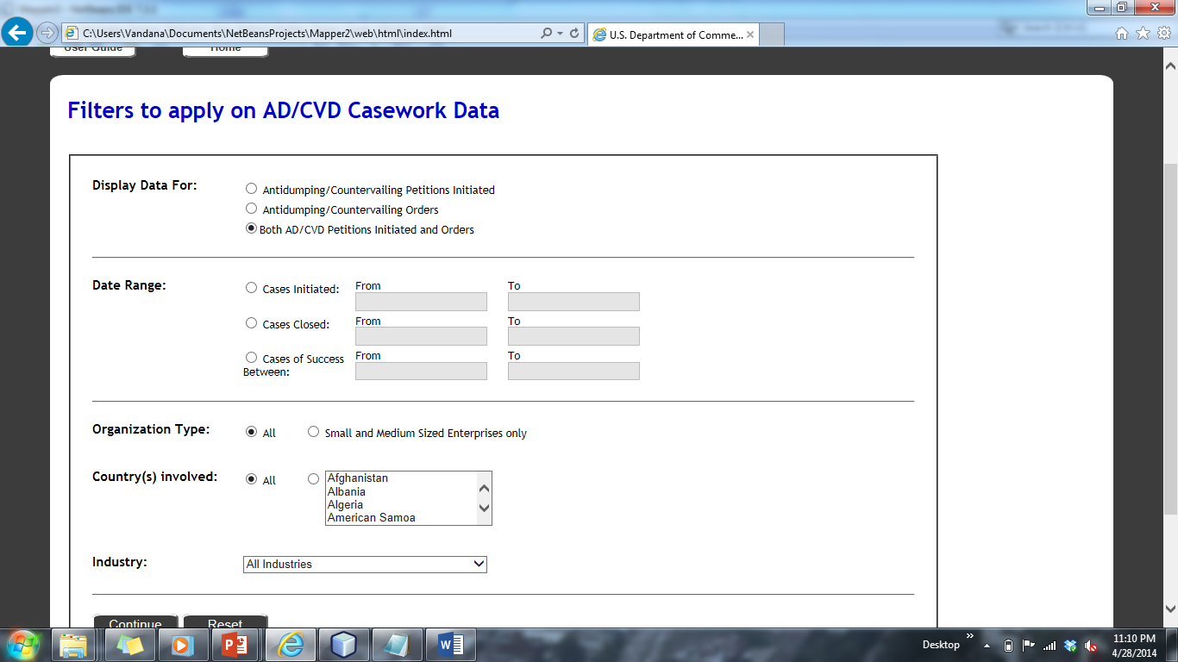
Categories Filter Forms AD/CVD Actions

Slide 19
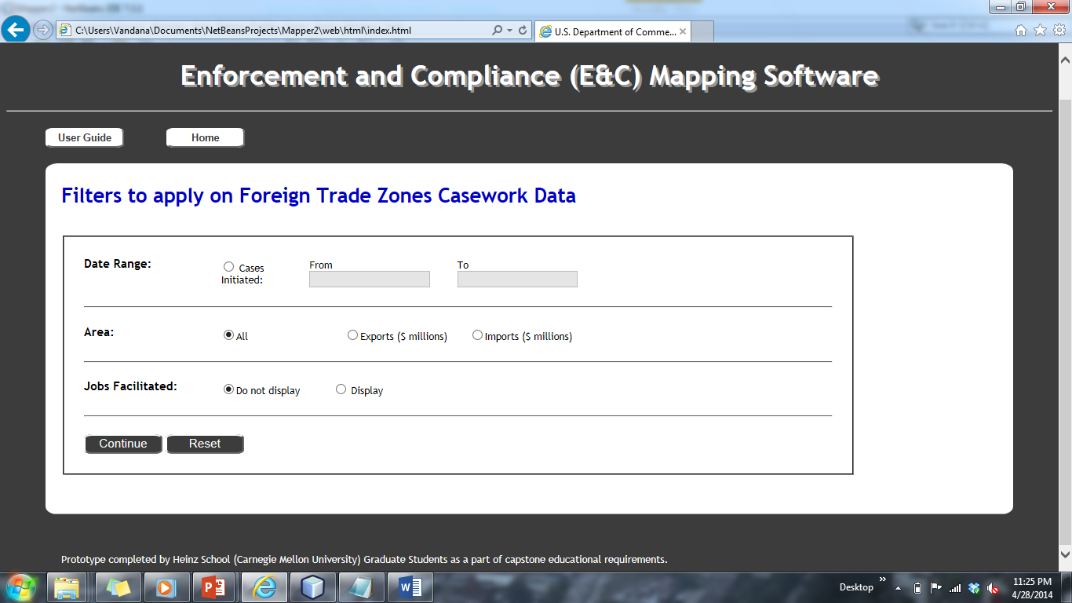
Categories Filter Forms Foreign Trade Zones

Slide 20
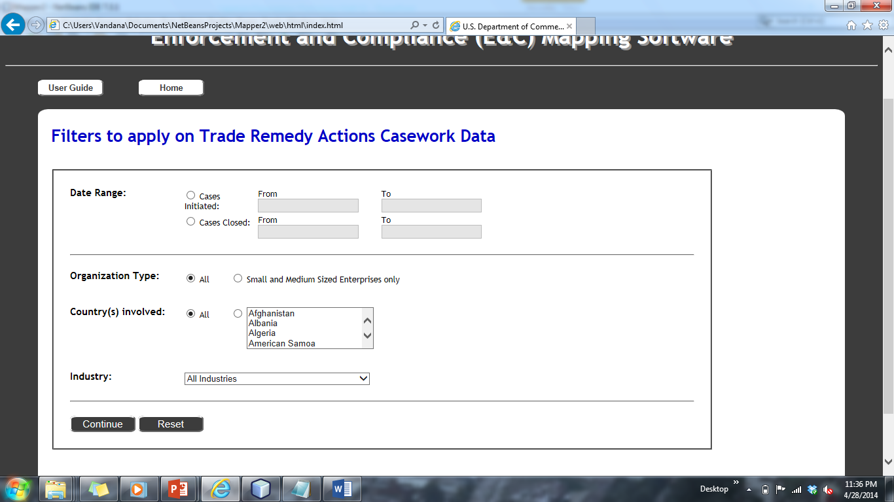
Categories Filter Forms Trade Remedy Actions

Slide 21
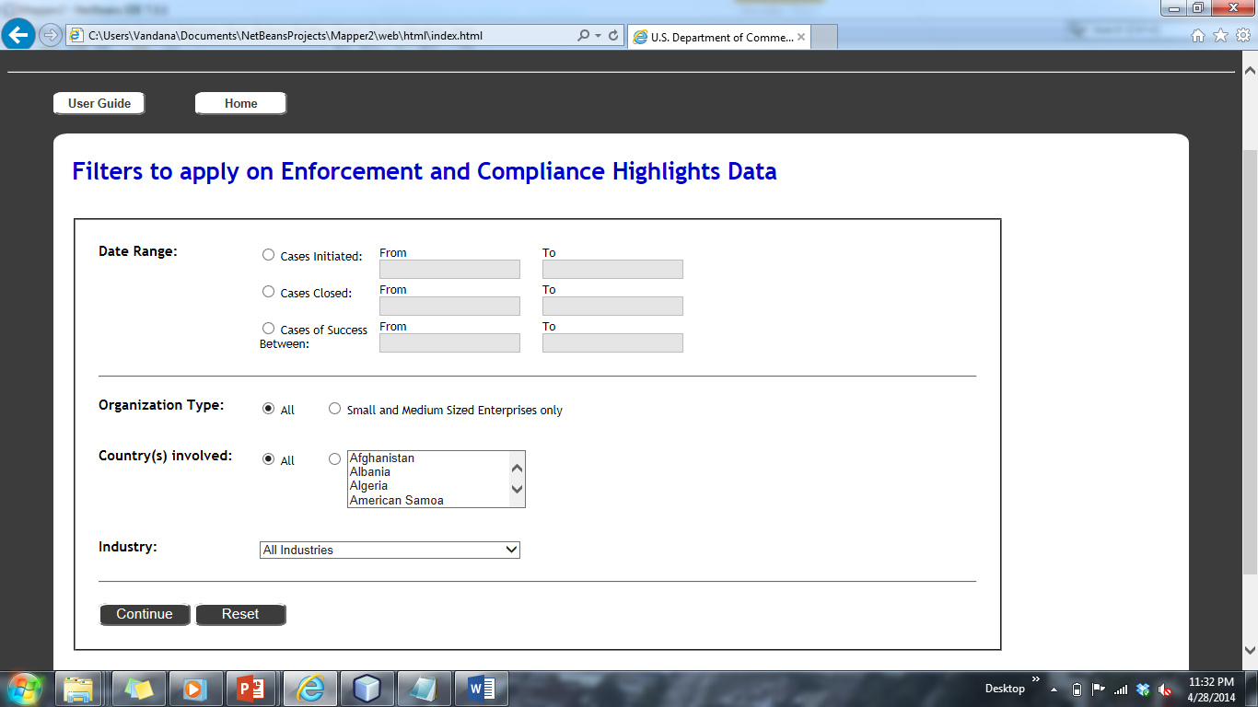
Categories Filter Forms Enforcement and Compliance Highlights

Slide 22
Software Development Practices
Hybrid Model (SDLC plus SCRUM)
Weekly Sprints for each phase of SDLC
Code Versioning - GitHub
Communication
Weekly Client Calls
Google Group / Emails
Deliverables
Archives
Admin Guide/User Guide
Final Report

Slide 23
Implementation Challenges
Browser compatibility
Java security settings
Keeping it simple

Slide 24
Scope for Future Work
Extend TANC data processing logic for remaining data categories:
AD/CVD Actions
Trade Remedy Actions
Foreign Trade Zones
Enforcement and Compliance Highlights
Extend maps display types:
bubble world/US maps
pinpoint cities with relevant information.
Extend implementation: other visualizations like bar charts.

Slide 25
Recommendations
Enhance compatibility with other browsers: Third party certificates required
Ensure consistency of data: Database connectivity
Utilize the scalability of the application: Web based solution
Notes:
Our client uses Chrome and IE, and at this moment this application only work for IE. As Sonal mentioned, there are several security issues to make it work on Chrome. So it is doable, and it would make the client usage more flexible, but it would require a third party certification.
So far, the data is stored in excel files. Every time the user has to get the excel file and import it. But if there is a database as a backend which stores all data, it would be more convenient. The user don’t have to repeat the file importing step. The application would connect to the database and the user only need to choose the filter. Another advantage of a database is data consistency. If data are record in several excel files, it is hard to make sure that everyone is using the right file. But with a centralized data storage, it can easily be achieved. Besides, from the point of view of the software maintenance, it would be better if the application connects with a database. Because our application is customized to the currently excel file. If the excel is changed, such as renaming a column, it is likely that the application cannot fetch the data correctly. But if the application is connected with a database schema, it is much easier to maintain it.
The fourth recommendation is to step further, not only building data, but also putting it and the application on a Web server, and make the application accessible on an internal network in the department. It is helpful to reduce the information redundancy. For example, the data TANC collect might be overlapping with some data other teams collect. If there is a centralized database among all teams, then all teams can save efforts and time on collecting and updating the data. And a centralized the application maintenance is more stable as well. The functions each team uses may be different, but the business logics are the same. It would be very time-consuming and not efficient if each team build their own application. If there is centralized application platform, it is easier to maintain all applications. A good thing is, our application is built on web standards, so if our client decide to put it on web, developers can directly use it as a pattern without much modification.

Slide 26
Q&A

Slide 27
Appendix
D3 - Data driven documents
Open source javascript
Document Object Model based on Web standards
Flexible extensions for data visualization
Use browser to show the maps shape images
SW Requirement: Browser (IE 9 /Chrome/FireFox)

Slide 28
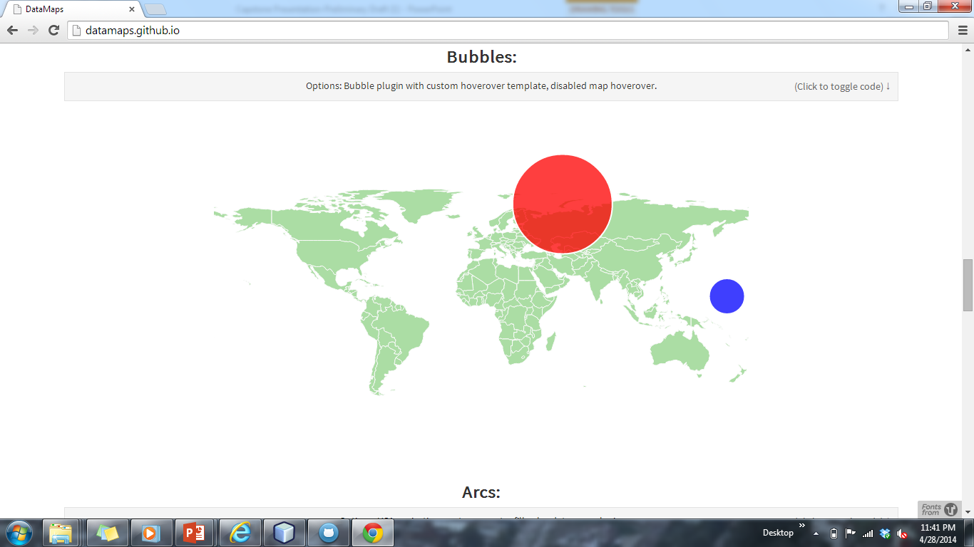
References
D3 - http://d3js.org/
DataMaps - http://datamaps.github.io/
Bubble Maps –

